Slide 1
JIT HACKATHON 2020
THEME : EDUCATION
BY,
TEAM –”THE YONKOS”
NISHANTH P
ROHITH D
OMKAR DESHPANDE
RANJITH KUMAR C

Slide 2
PROBLEM STATEMENT :
Students after passing 2nd PUC have difficulty in choosing the course and college they want to enroll and pursue their career.
SOLUTION IN BRIEF :
There are about 4000+ engineering colleges established in India . In addition to that each colleges offers a number of courses for you to choose. So in order to make is simpler and less complicated ,we have come up with an website that lists all the top colleges in each of India and the courses they have to offer . Now students can select the college they want to enrol in the state that like and choose an course that they are available to them . We have also listed the latest cut-off ranking for each course that’s been provided by the college.
NOTE :
The ranking of a college in that particular state is based upon NIRF (a methodology adapted by the MHRD to rank institutions of higher education) , percentage of students passing out each year ,number of placements and average placement salary per annum(INR ).

Slide 3
REASON TO CHOOSE THIS TOPIC :
When we passed out after writing the 12th or 2nd PUC board exam we faced the above same problem , we could not decide which college to join and which course to pursue . We did not know how truly good the colleges were and few of my friends and relatives joined colleges by making hasty decisions and are suffering now . We did not want this problem to be faced by our junior generation students and we came up with a solution to develop a website as mentioned .
APPROACH TOWARDS THE SOLUTION :
We used the following languages to build our website :
CSS
JAVA
HTML
We have used a software called ‘blogger’ to implement our website which offers free hosting and domain.
We have also used a software called ‘corel draw’ to design our website.

Slide 4
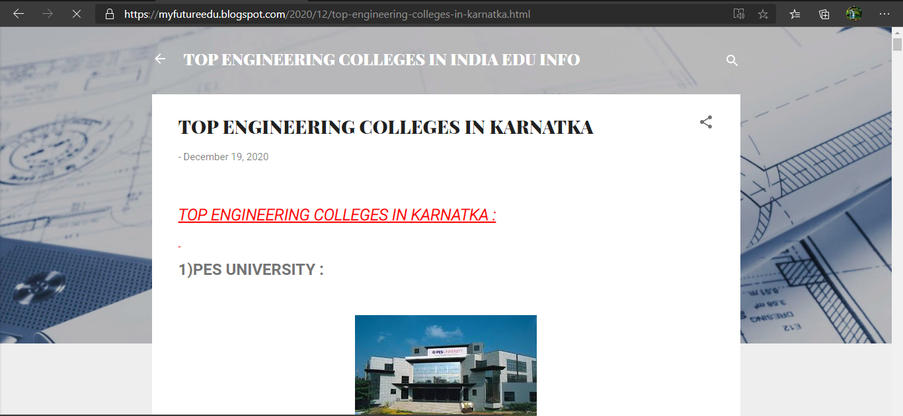
FEW INSIGHTFUL PICS OF OUR WEBSITE:

Slide 5
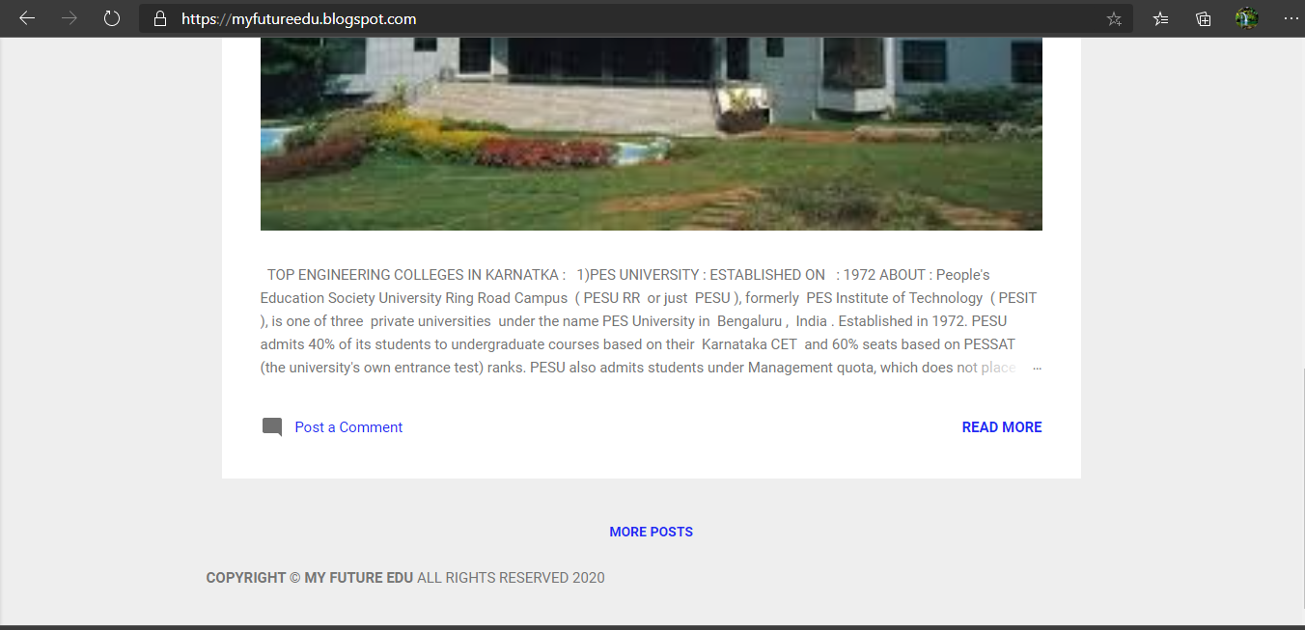

Slide 6
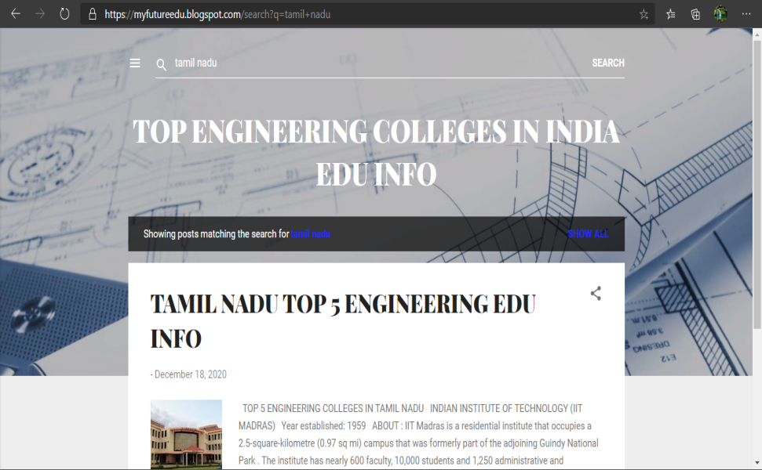

Slide 7
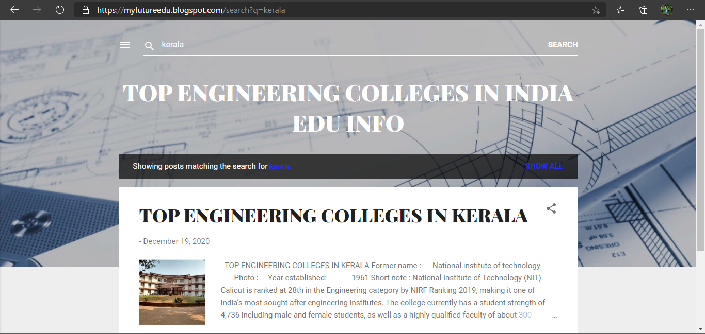

Slide 8
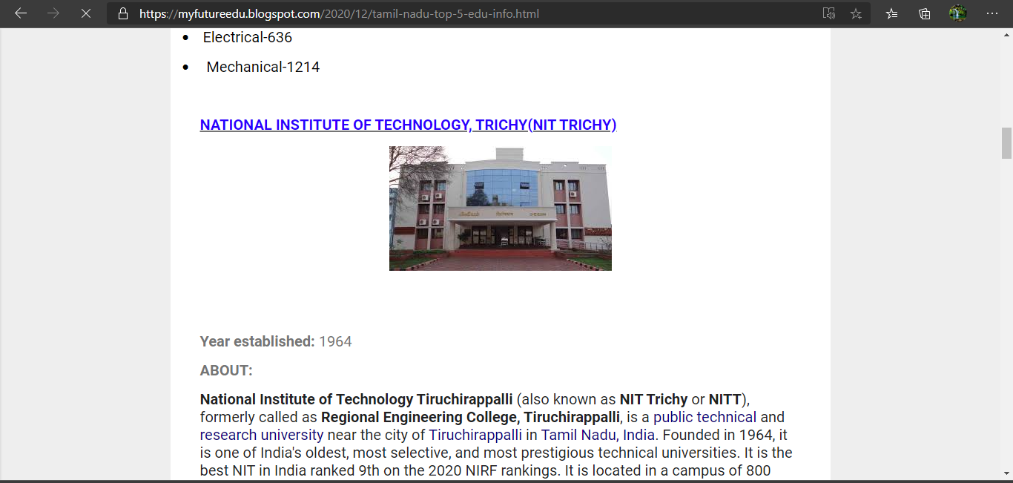

Slide 9
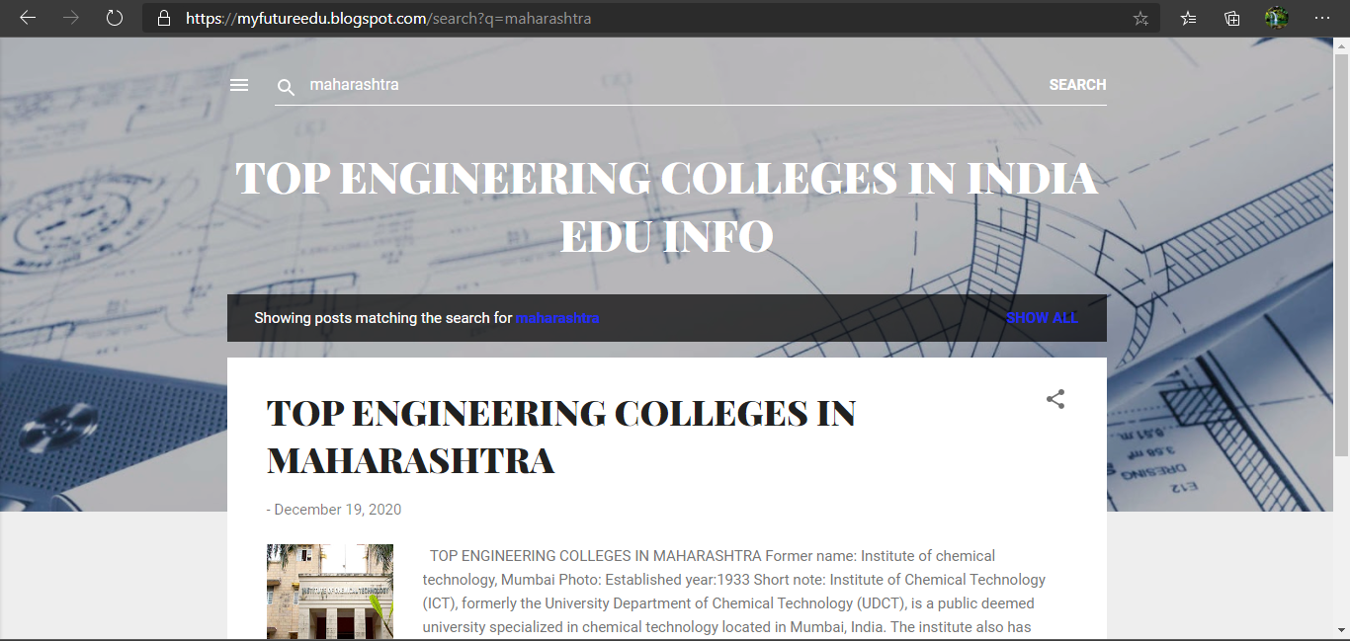

Slide 10
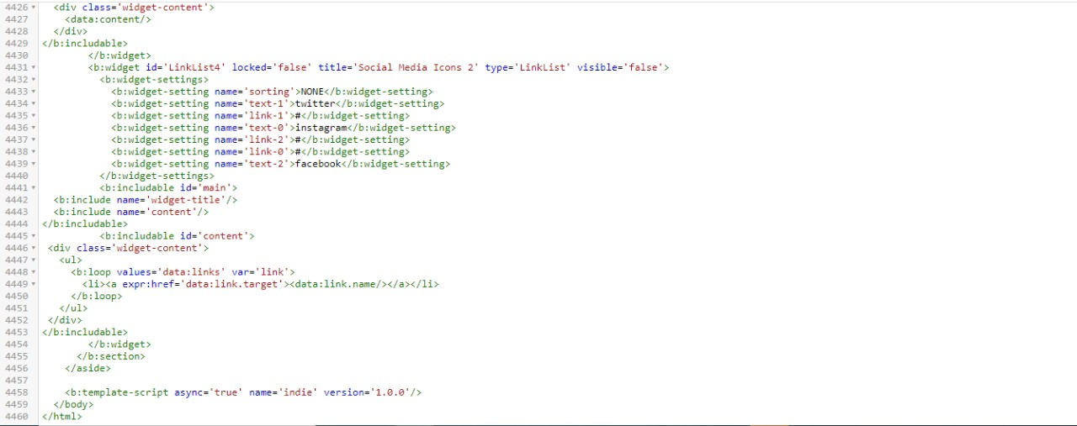
HTML AND CSSCODE

Slide 11
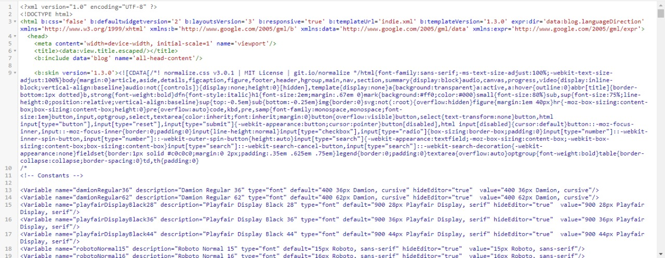

Slide 12
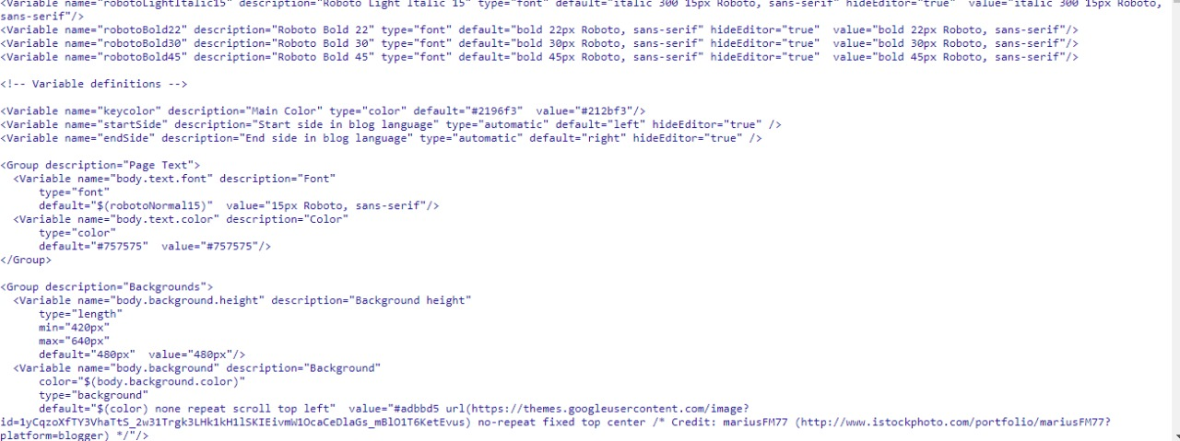

Slide 13
WEBSITE LINK :
TOP ENGINEERING COLLEGES IN INDIA EDU INFO (myfutureedu.blogspot.com)

